Slide 1

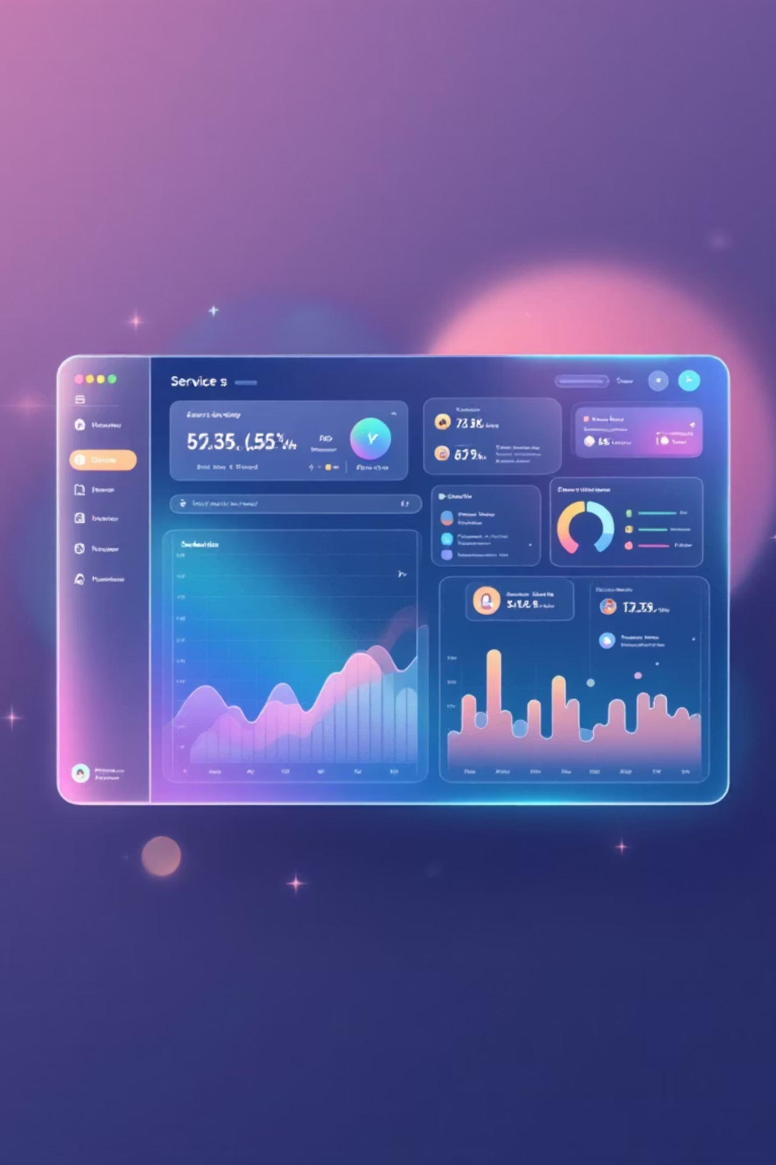
Service Management System
A comprehensive full-stack web application that revolutionizes enterprise service request management, streamlining the entire lifecycle from customer submission through technician assignment, service completion, billing, and feedback collection.

Slide 2
PROBLEM STATEMENT
Challenges in Traditional Service Management
Manual Request Handling
Inefficient Assignment
Zero Visibility
Service requests scattered across phone calls, emails, and paper forms create chaos. No centralized tracking system means lost requests, forgotten follow-ups, and frustrated customers.
Manual technician assignment leads to workload imbalance and service delays. No visibility into availability means some technicians are overwhelmed while others sit idle.
Customers left in the dark about service status. No automated updates force endless manual follow-ups, creating frustration and wasting valuable time.
Complex Billing
Poor Feedback Loop
Limited Analytics
Manual invoice generation is error-prone and slow. Payment processing delays hurt cash flow, and manual tax calculations increase compliance risks.
No systematic customer feedback collection means service quality issues go undetected. Without data-driven insights, continuous improvement becomes impossible.
Manual report generation is time-consuming and outdated by the time it's complete. No real-time visibility into performance metrics blinds leadership.

Slide 3

PROPOSED SYSTEM
Comprehensive Digital Service Management Platform
Unified web-based Service Management Platform
Centralized service request creation and tracking
Intelligent technician assignment based on workload
Automated service workflow with real-time updates
Integrated billing, payments, and feedback system
Role-based dashboards with analytics and reports
Automatic invoice generation with 18% GST calculation, multiple payment modes, and comprehensive payment tracking.

Slide 4
KEY FEATURES
Enterprise-Grade Capabilities
01
02
03
Role-Based Access Control
Complete Request Management
Smart Assignment & Scheduling
Four distinct user roles with JWT-based authentication, BCrypt password hashing, and role-based API authorization ensuring security at every level.
Customers browse services by category, create detailed requests with location and preferred dates, track status in real-time, and maintain complete service history.
Service managers view pending requests, check technician workload, assign based on capacity, with automated notifications and reassignment capabilities.
04
05
Task Management
Automated Billing
Technicians view assigned tasks with customer details, update status through defined workflow, access contact information, and track completion statistics.
Auto-generate invoices upon completion with unique numbering, calculate subtotal and 18% tax, support multiple payment modes, and track payment status.

Slide 5





Advanced Analytics & Insights
Role-Specific Dashboards
Admin, Manager, Technician, and Customer dashboards provide tailored views of system-wide statistics, workload distribution, task schedules, and service history.
LINQ-Powered Reports
Complex queries analyze service requests by status, calculate technician workload, generate monthly revenue reports, and rank popular services.
Customer Feedback System
5-star rating system with detailed comments linked to service requests enables continuous improvement and satisfaction tracking.
Real-Time Notifications
Automated alerts for request creation, technician assignment, status updates, and payment confirmation with role-specific filtering.

Slide 6


TECHNOLOGY STACK
Modern, Scalable Architecture
Frontend Technologies
Backend Technologies
Security & Data
Angular 17+ - SPA framework
.NET Core 9.0 - API framework
SQL Server - Relational database
TypeScript 5.x - Type-safe development
C# 12.0 - Primary language
JWT - Stateless authentication
Entity Framework Core 9.0 - ORM
BCrypt - Password hashing
Angular Material 17+ - UI components
ASP.NET Core Web API - RESTful APIs
CORS - Cross-origin security
RxJS 7.x - Reactive programming
LINQ - Data querying
HTML5/CSS3 - Modern web standards
Architecture Patterns
Development Tools
Layered architecture with Repository and DTO patterns, leveraging .NET Core dependency injection for maintainable, testable code.
Visual Studio 2022 for backend, VS Code for frontend, SQL Server Management Studio, Postman for API testing, and Git/GitHub for version control.

Slide 7

SYSTEM ARCHITECTURE
Three-Layer Architecture Design
Data Layer
Application Layer
SQL Server database with 10 normalized tables: Users, Roles, ServiceCategories, Services, ServiceRequests, TechnicianAssignments, Invoices, Payments, Feedback, and Notifications with proper foreign key relationships.
Presentation Layer
.NET Core 8.0 Web API containing API Controllers for each role, Business Logic Services (UserService, ServiceService, RequestService, AssignmentService, BillingService), and Data Access Layer using Entity Framework Core with LINQ.
Angular 17+ SPA with four distinct user interfaces: Admin UI for system management, Manager UI for assignments, Technician UI for task execution, and Customer UI for service requests. Communicates via HTTP/HTTPS REST APIs.
RESTful API Design: 25+ endpoints organized by functionality including /api/auth for authentication, /api/admin for system management, /api/servicerequests for customer operations, /api/manager for assignments, /api/technician for tasks, and /api/reports for analytics.

Slide 8
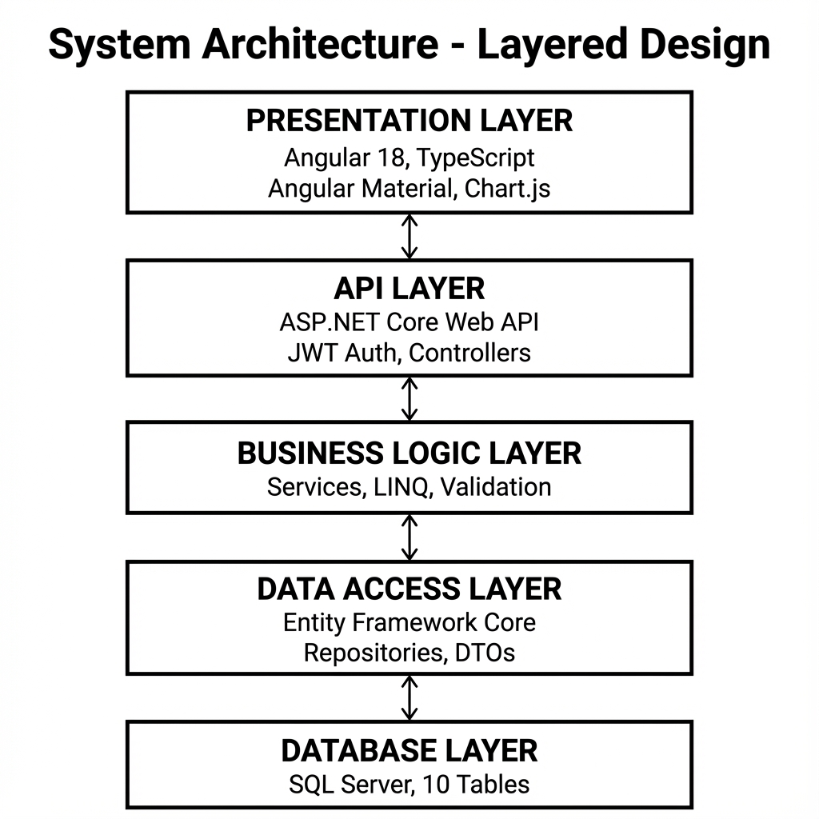

Slide 9
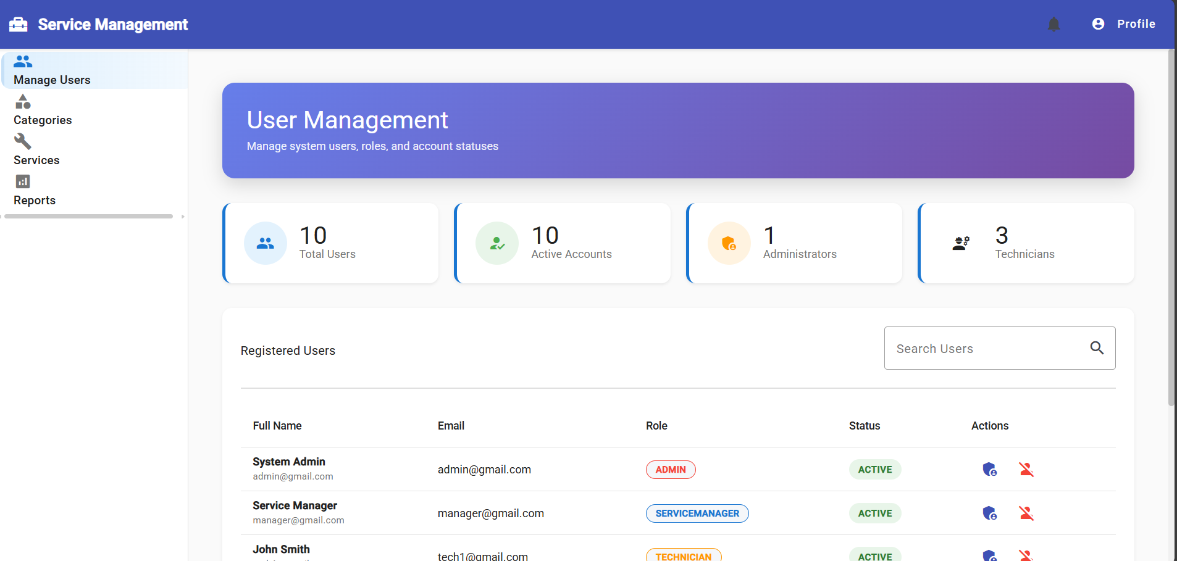
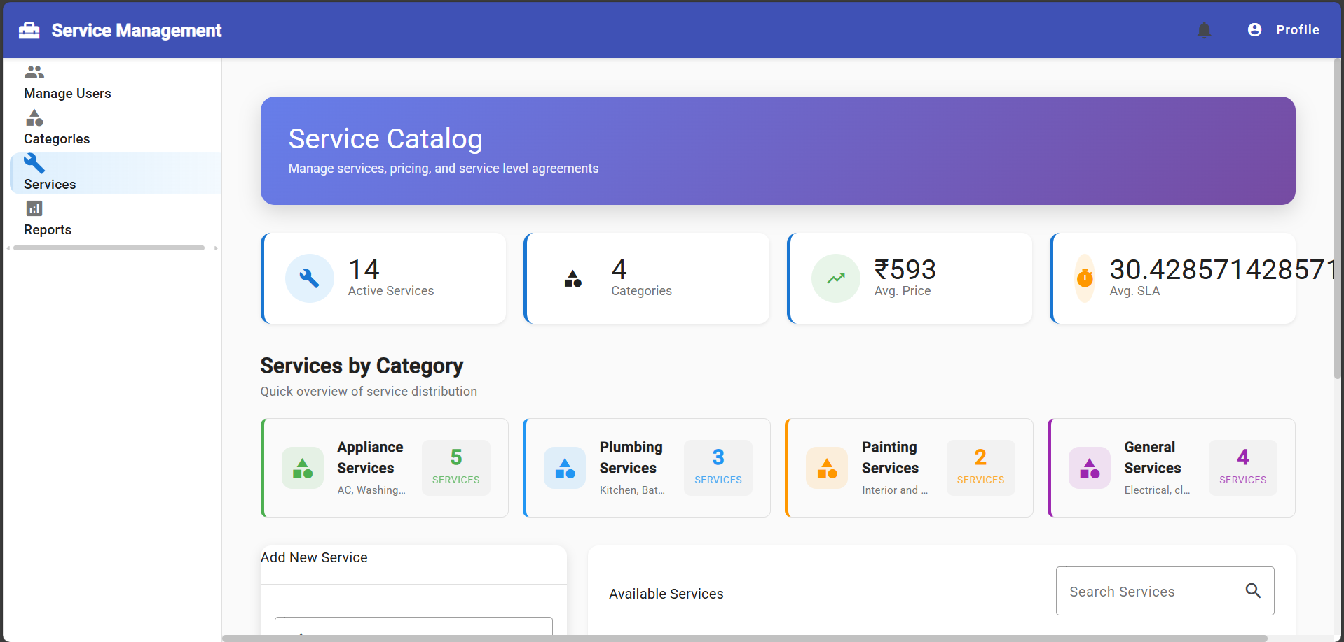
USER MANAGEMENT SCREEN

Slide 10
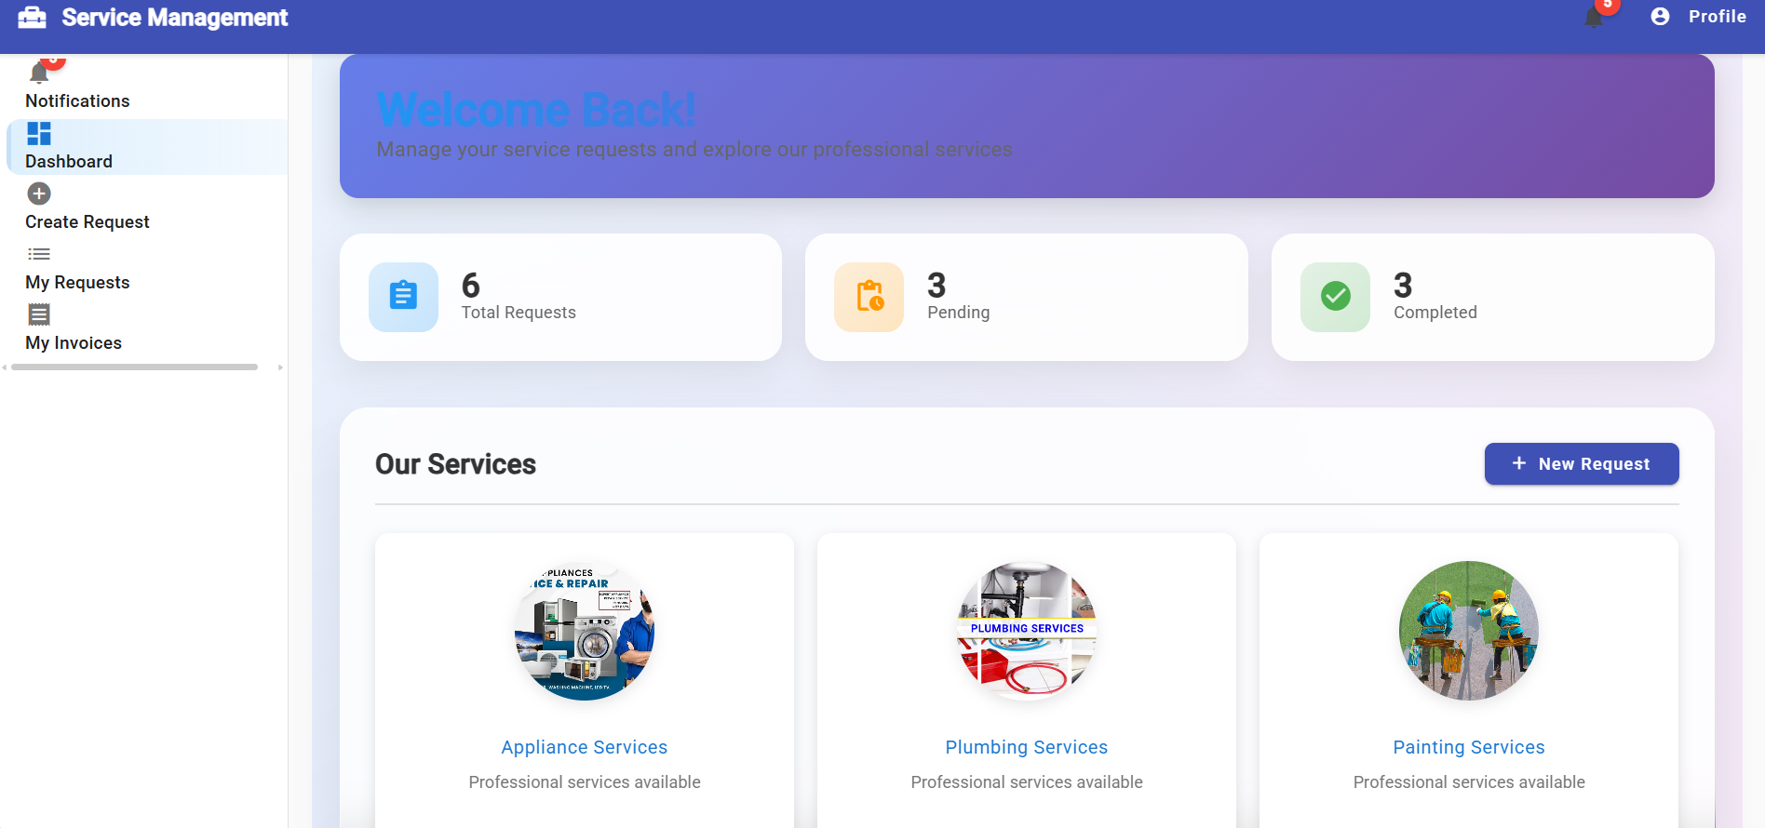
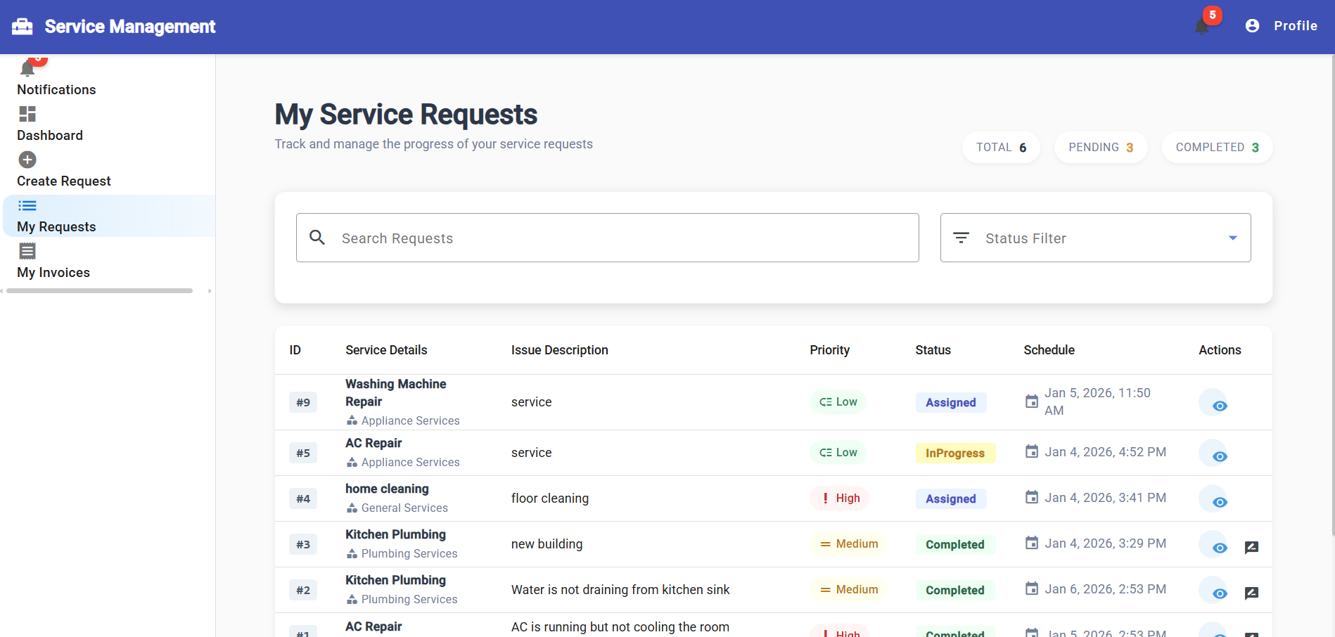
USER /CUSTOMER SCREEN

Slide 11


REPORTS & ANALYSIS
Comprehensive Reporting & Analytics
Service Request Analytics
Revenue Analytics
Requests grouped by status with visual distribution
Monthly revenue reports with year-over-year comparison
Category-wise request analysis for resource planning
Revenue by service category breakdown
Paid vs. pending invoice tracking
Date range filtering for trend analysis
Revenue trends and growth forecasting
LINQ GroupBy queries for efficient aggregation
Technician Performance
Customer Feedback Insights
Active assignments and workload per technician
Overall average ratings and distribution
Service-wise satisfaction scores
Completion rates and efficiency metrics
Customer satisfaction ratings per technician
Rating trends over time for quality monitoring
Average task completion time tracking
Common themes identification from comments

Slide 12




RESULTS
Measurable Business Outcomes
80%
60%
Quicker Assignment
Faster Processing
Reduction in service request processing time through automation
Faster technician assignment with intelligent workload balancing
90%
100%
Billing Efficiency
Full Automation
Reduction in manual invoice generation time with automation
Automated status tracking and real-time notifications

Slide 13
CONCLUSION
Enterprise-Grade Service Management Solution
The Service Management System successfully demonstrates the development of a comprehensive, enterprise-grade web application that addresses real-world service management challenges through intelligent automation, real-time visibility, and data-driven insights.
This capstone project showcases proficiency in full-stack web development, modern software architecture, database design and management, API development and integration, user experience design, and software testing and quality assurance.
Technical Excellence
Business Impact
Future Ready
Built with Angular 17+, .NET Core 8.0, and SQL Server using layered architecture, Repository pattern, and comprehensive LINQ queries for complex data operations.
Delivers 80% faster processing, automated billing, real-time tracking, and data-driven analytics that transform service management operations.
Scalable architecture supports planned enhancements including mobile apps, AI-powered assignment, payment gateway integration, and microservices migration.

